Slide 1
Google GCP and AI
Perth .Net Users Group
18th December 2018

Slide 2
Agenda
What is Google Cloud Platform?
Why focus on AI and some of the basics
I’m a developer, get me out of here!
Demo application
Lessons Learned

Slide 3
Organize the world’s information and make it universally accessible and useful

Slide 4
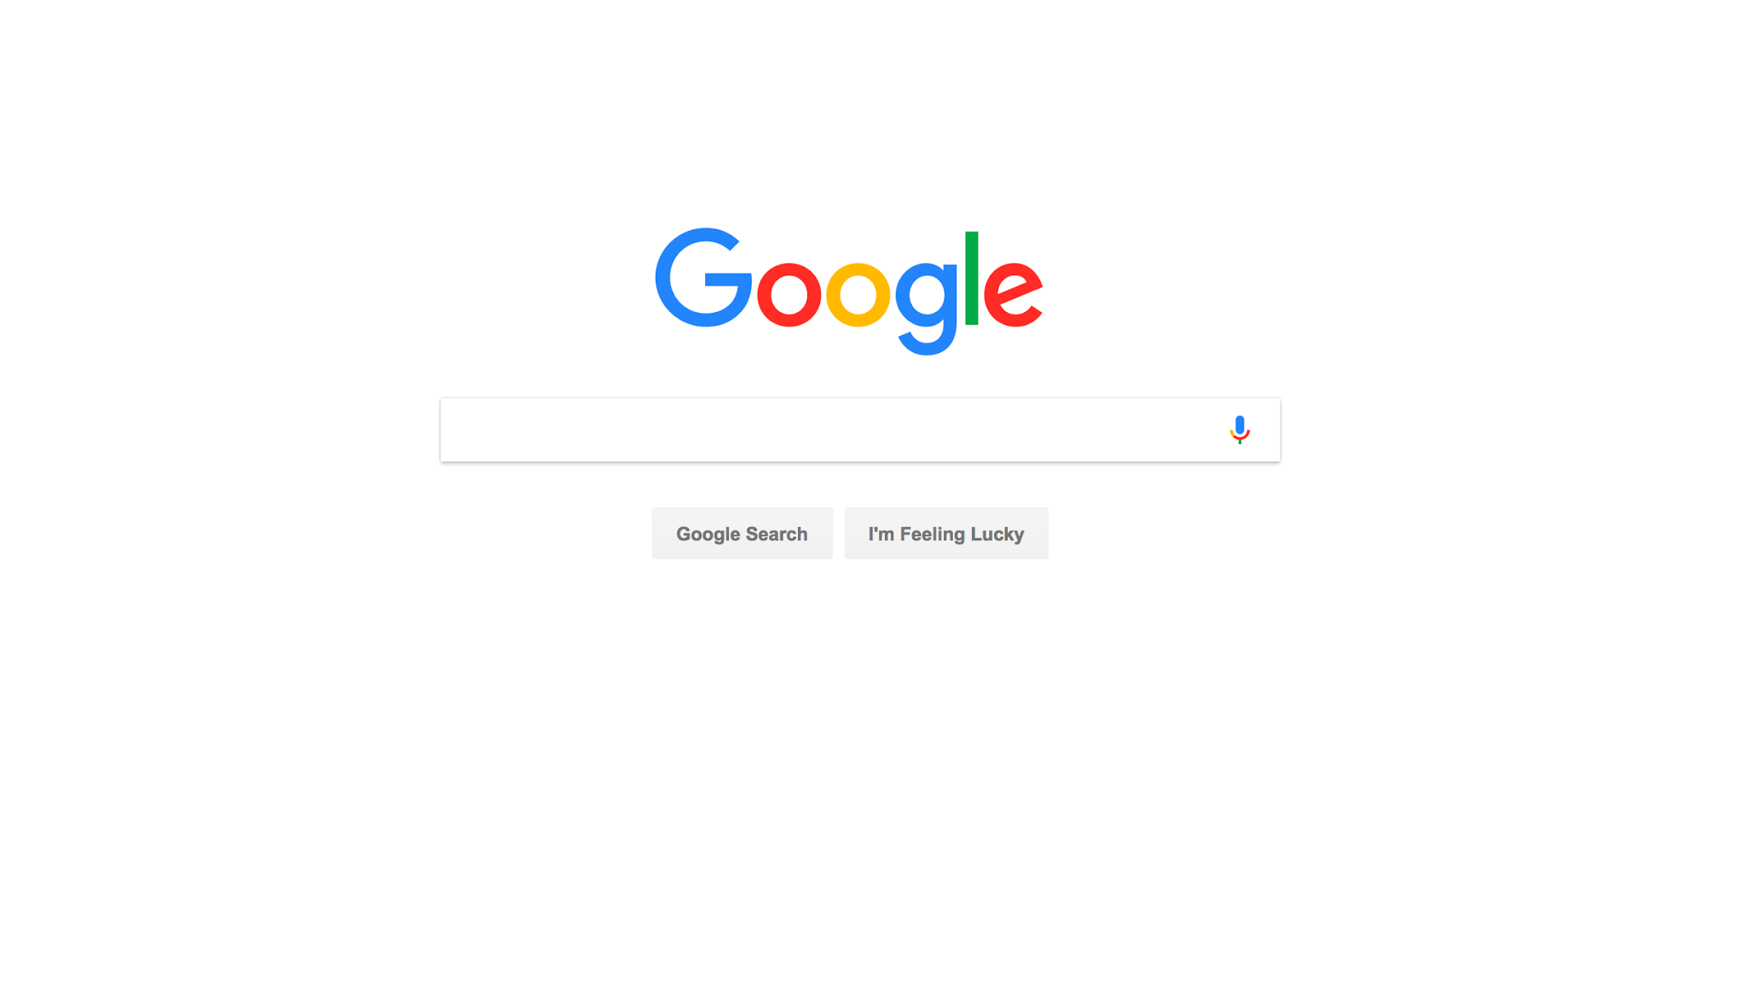
Notes:
And it all started with this simple website. And when I say the world “Google” - this is probably what comes to your mind. A simple search box.
But when I look at that screen, I don't’ see just a search box. I see this: <NEXT SLIDE>

Slide 5
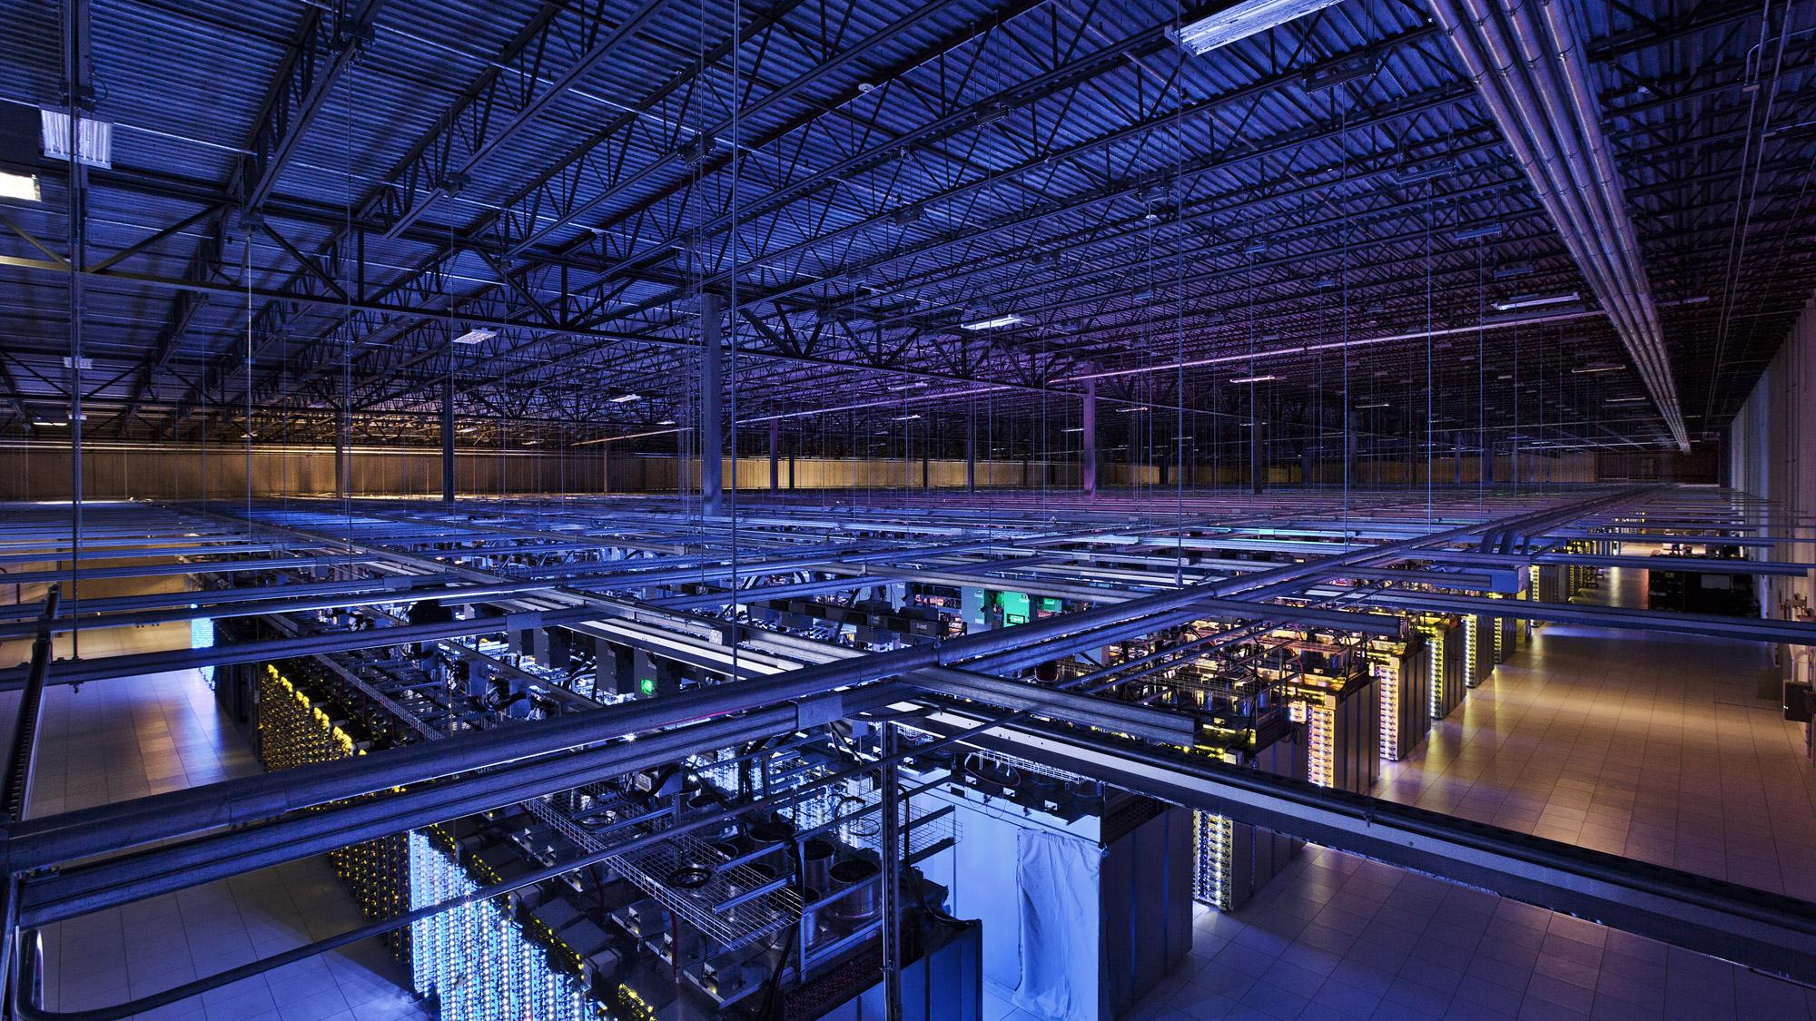
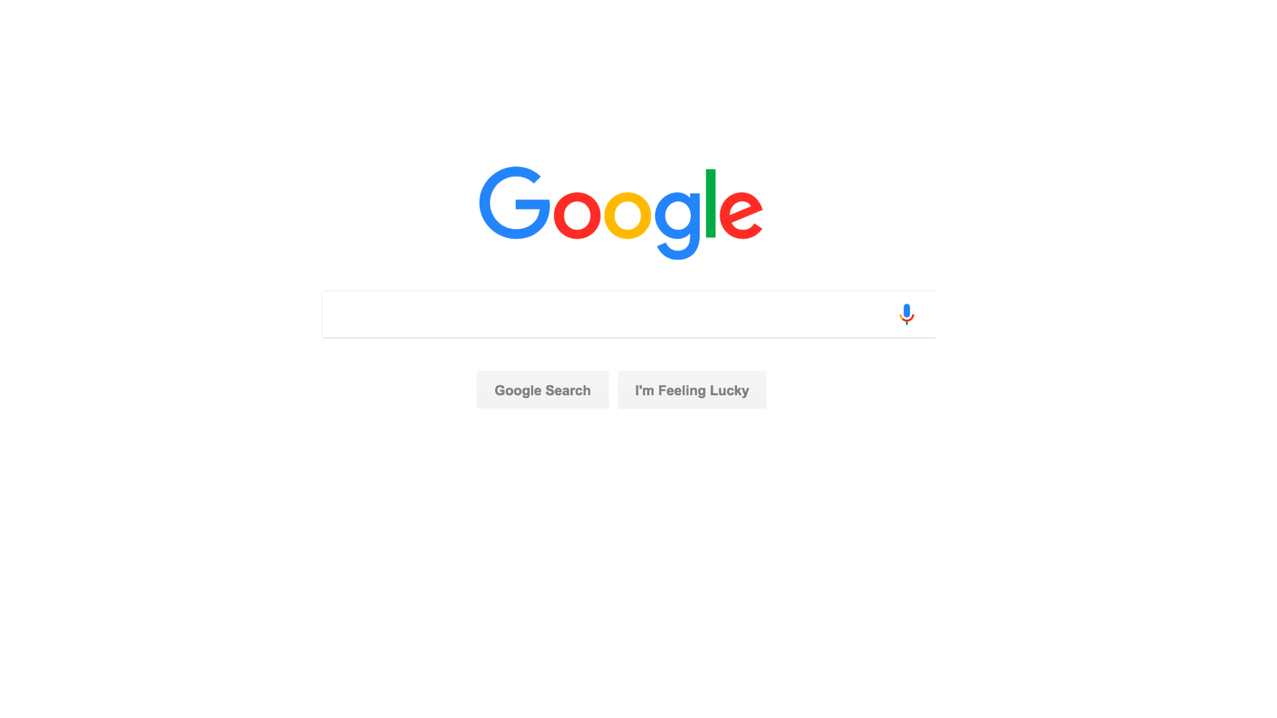
Notes:
I see all the infrastructure that make those wonderfully simple experiences possible. But if you recall that original mission to organize the world’s information, and recall that we started in 1999, you quickly realize that we had no choice but to invent a lot of new technology.
Think about it - it’s 1999 and you want to build a search engine for the entire web. That means you have to store multiple copies of the ENTIRE web. What database do you use? What file system? The fact is, there weren’t any that would be up to the job - not commercial and not open source.

Slide 6




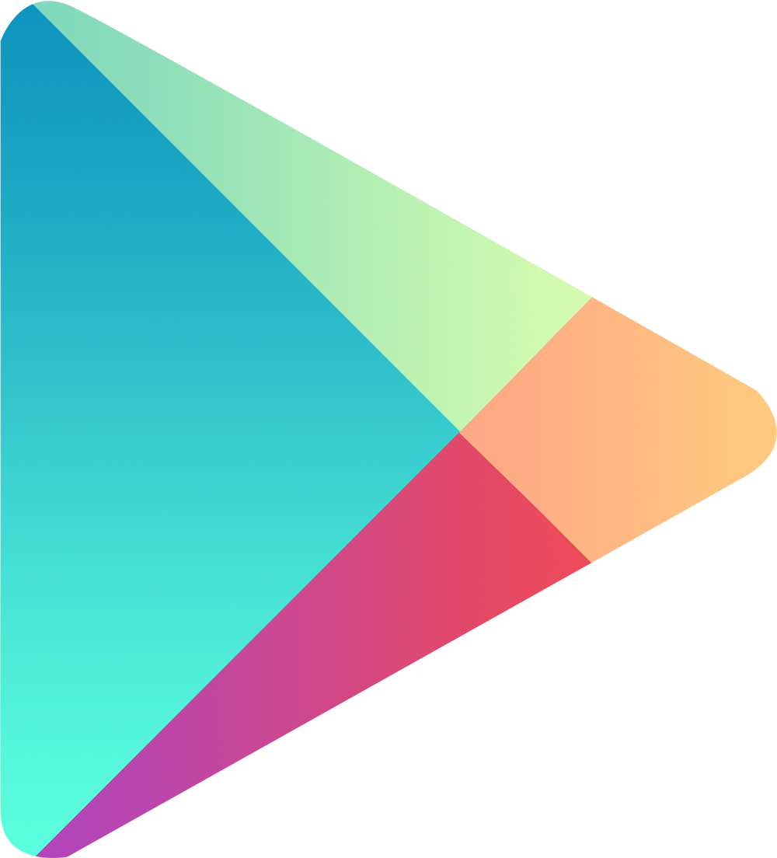
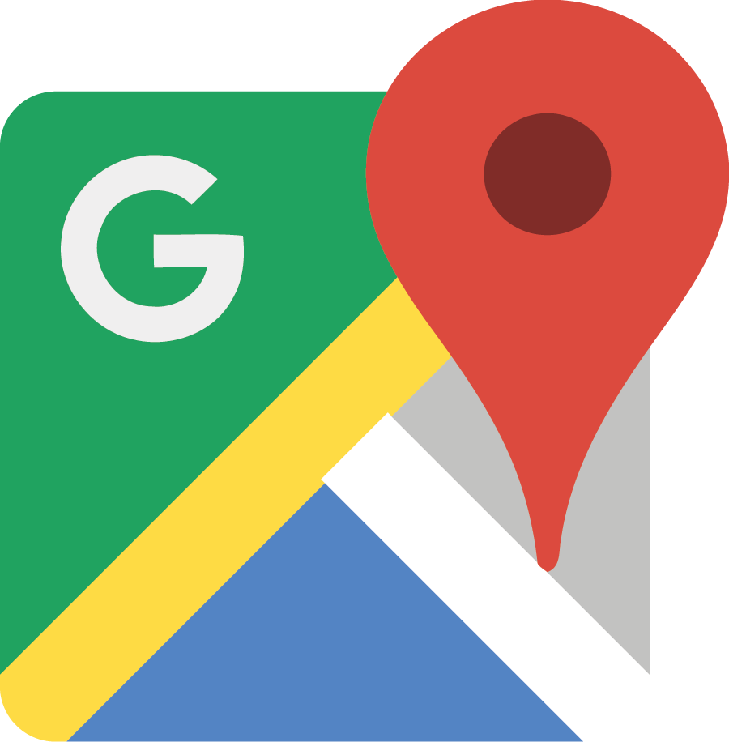

Seven cloud products
With one billion users each
Notes:
It’s this focus on infrastructure and improvement that let Google scale as we have - the point that today we have 7 cloud products each serving over 1 billion users.

Slide 7
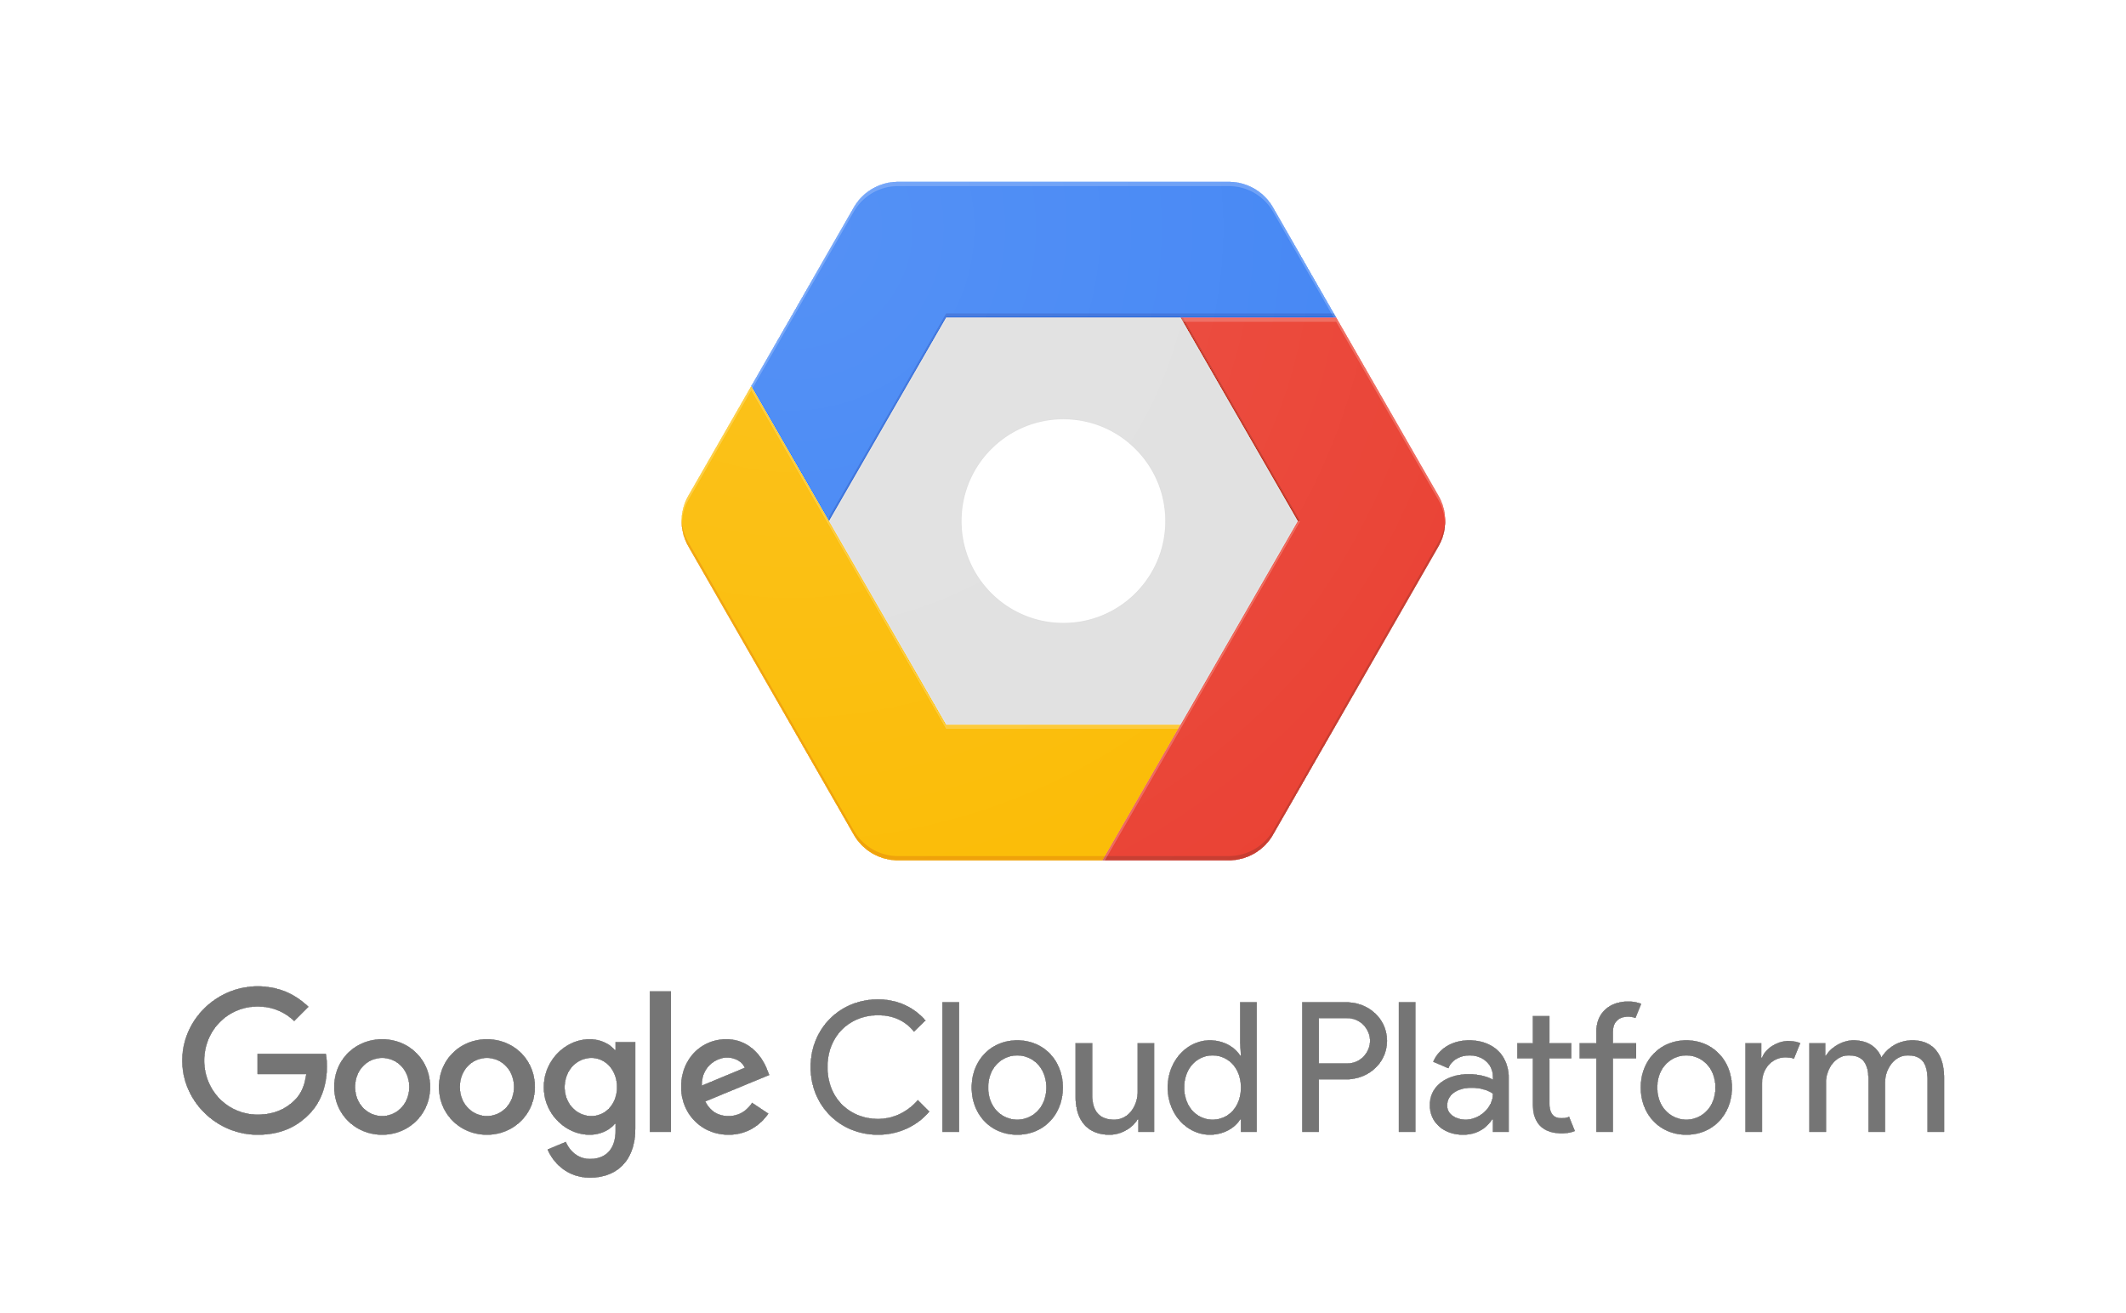
Use best of Google’s innovation to solve the problems that matter most to you
Notes:
And that’s basically what Google Cloud Platform is - a platform that lets you use our innovation to solve the problems that matter most to you.
So with that, let me dive into the specifics of how we’re different.

Slide 8
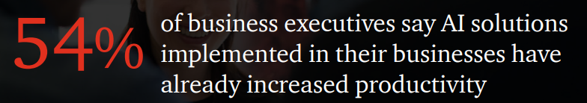
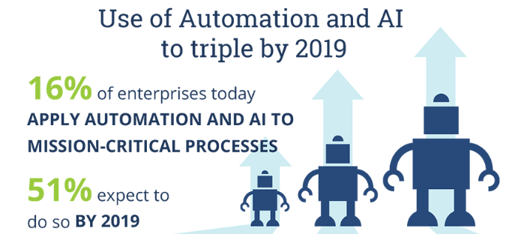
Why focus on AI?
(PwC Consumer Series 2017)
High adoption expected.
“No brain, no gain”
Two-thirds of companies
struggle with finding and
acquiring AI talent
83% struggle with retention.
One solution (Hire.google.com) is using AI to find AI developers.
To help bridge the gap, cloud suppliers are providing “pre-trained” models.
(ISG 2018)

Slide 9
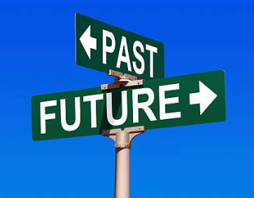
The basic AI Concept
In 1905 George Santayana a philosopher said, “Those who cannot remember the past are condemned to repeat it”
In 1980 Dr. Carl Sagan a cosmologist said, “You have to know the past to understand the present.”
In 2012 Robert T Kiyosaki an accountant said, “The best way to predict the future is to study the past, or prognosticate.”
AI model training is all about analyzing the past to predict the future.

Slide 10
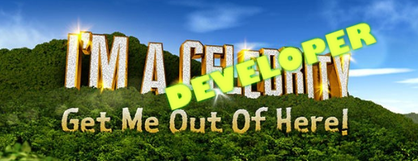
I’m a developer, not a data scientist
Neural Nets are not simple. Tools mainly are designed for data scientist by data scientist.
For Dev there are a few out of the box APIs
Vision API (Label, extract Text, Web search)
Video API (extract metadata)
Translation
Text-to-Speech
Natural Language (extract intent, main use is for Bots)
As always, it’s not long before you get to the last 10% for functionality that takes 90% of the effort.

Slide 11
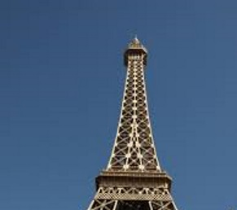
Landmark Example
Landmarks – Where is this?

Slide 12
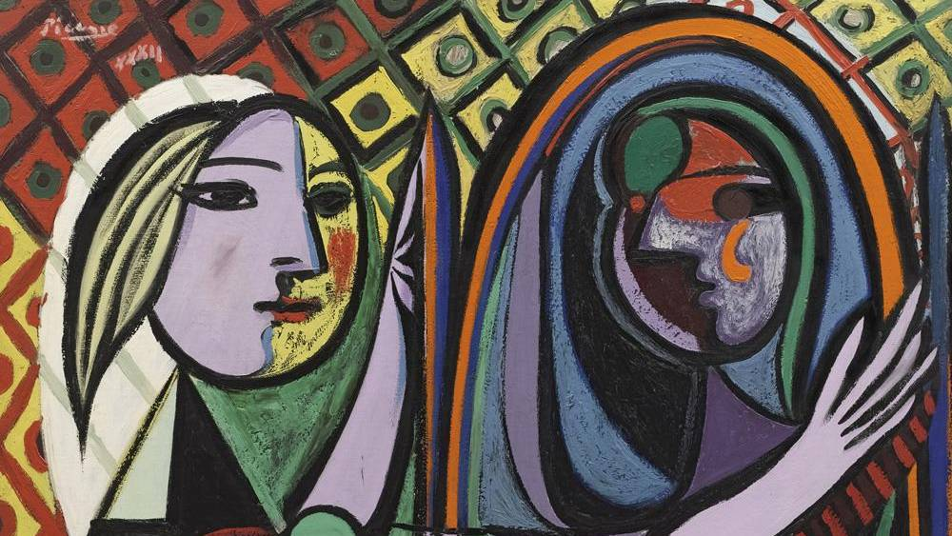
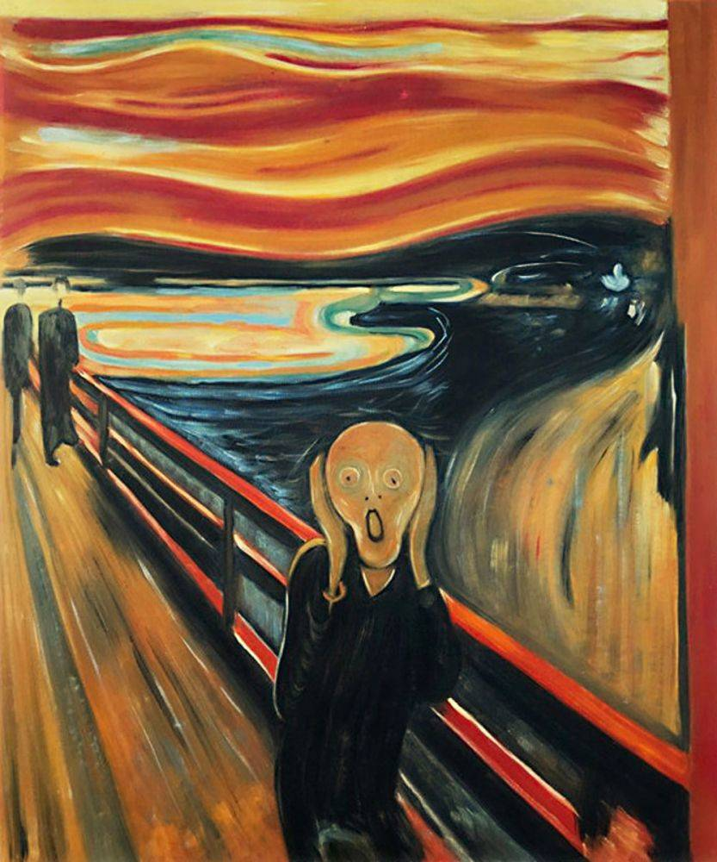
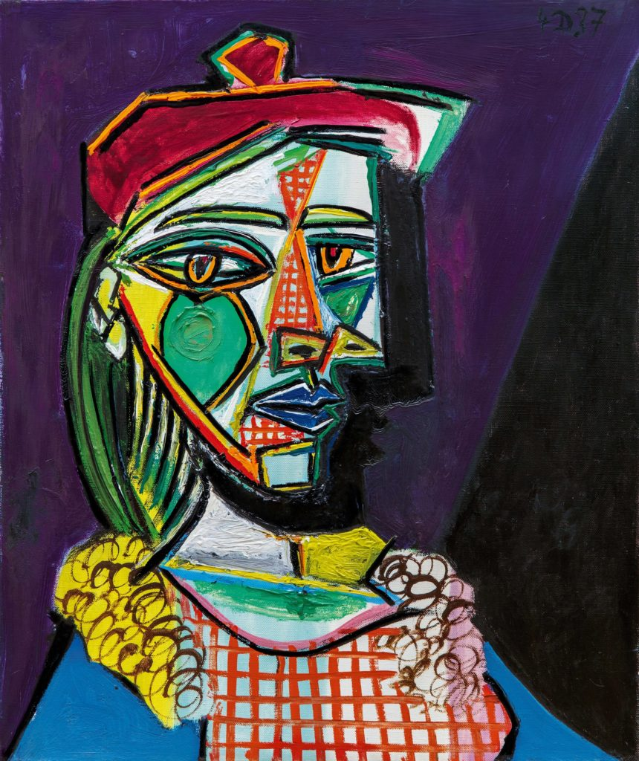
Label Example
Label – what description would you give?

Slide 13
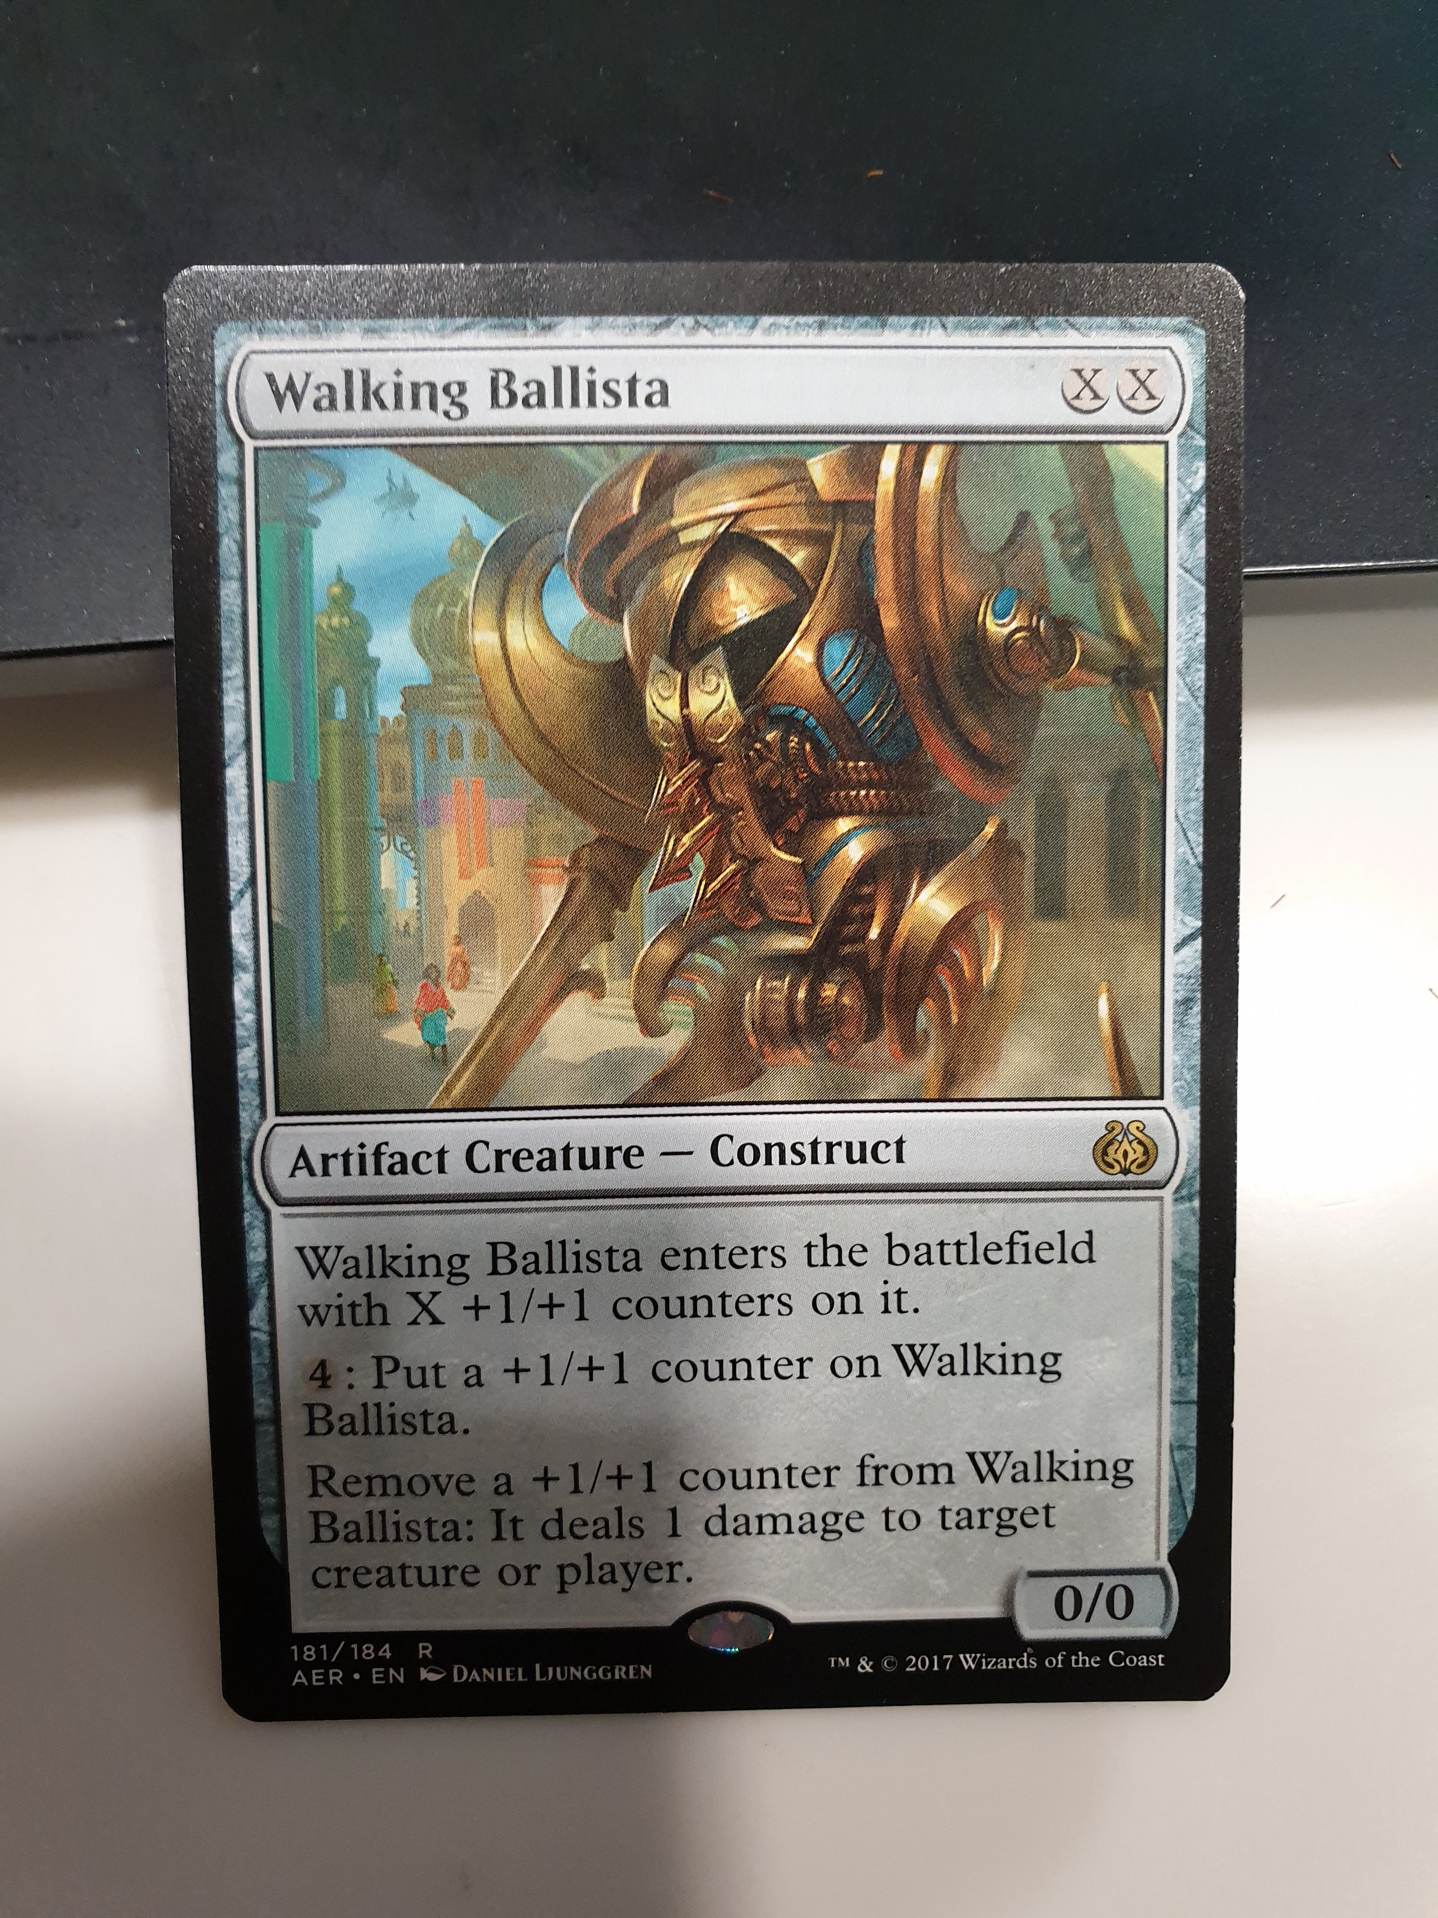
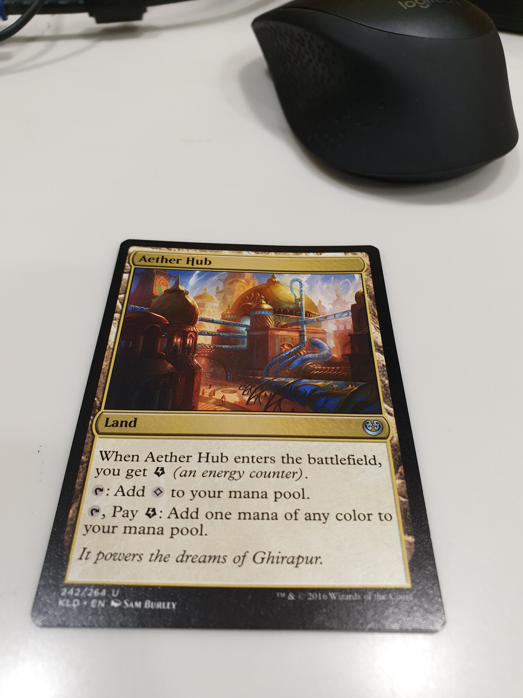
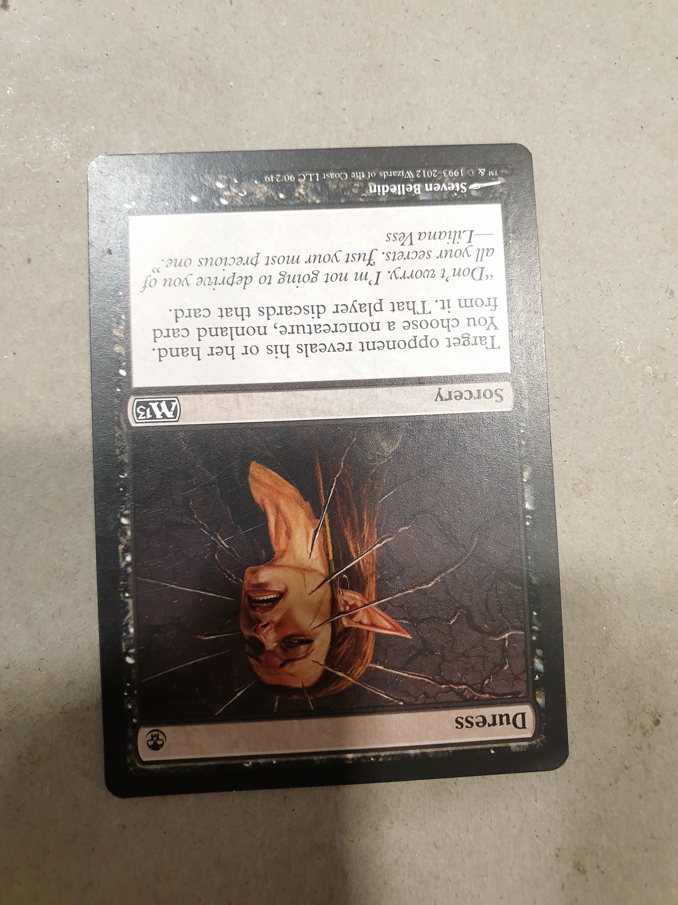
Text/OCR Examples
Text

Slide 14
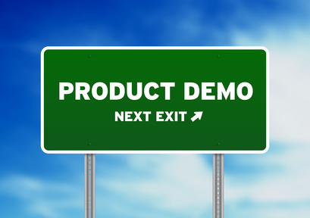
Demo

Slide 15

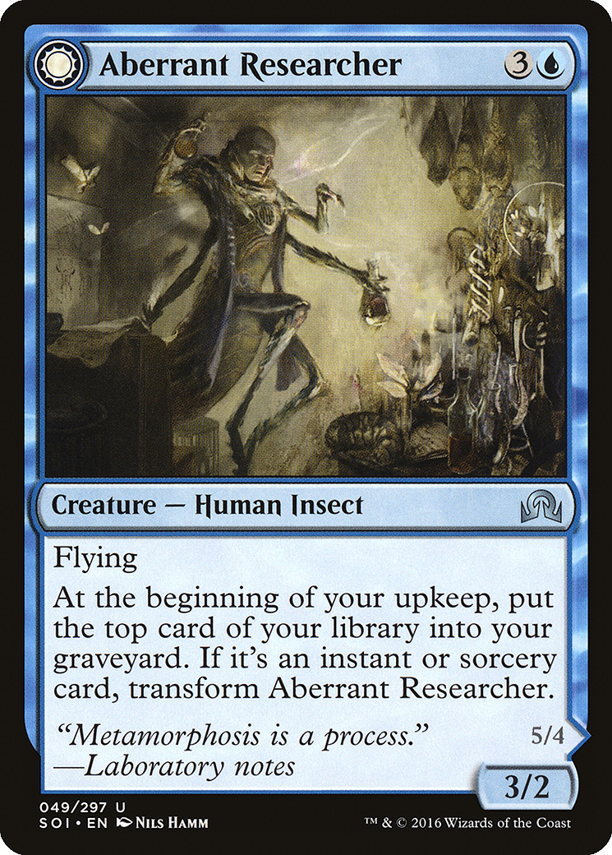
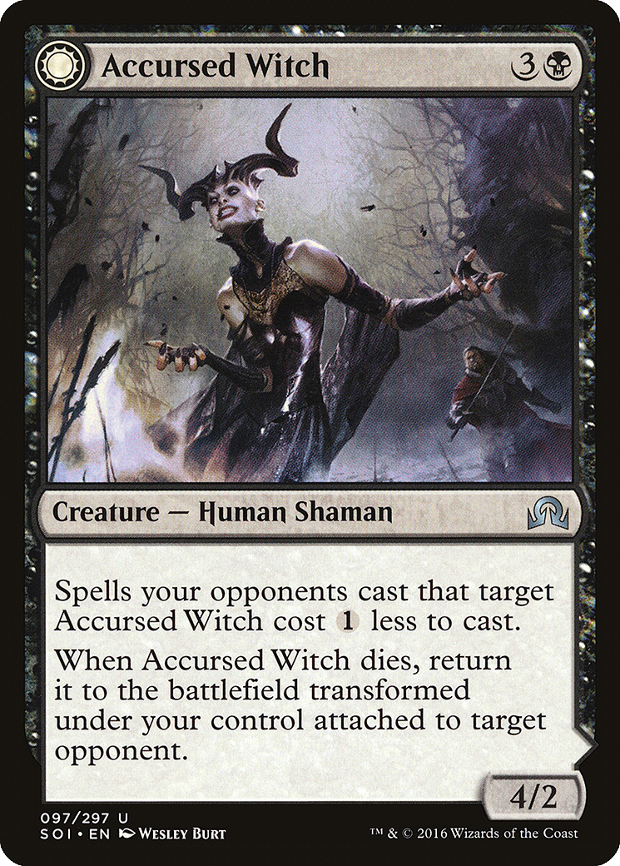
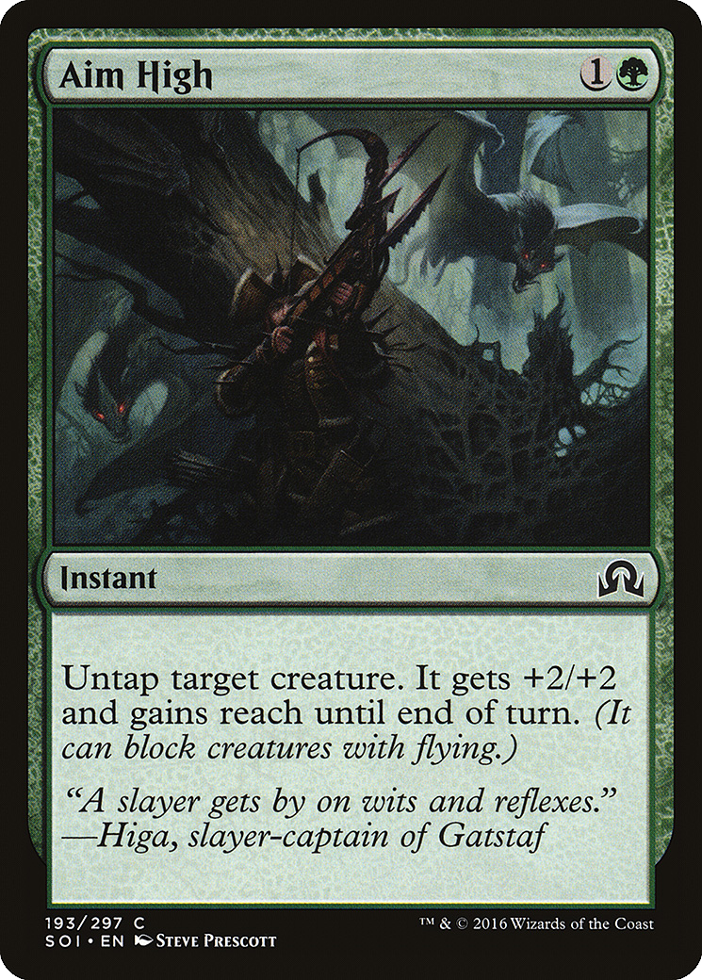
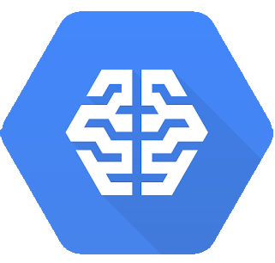
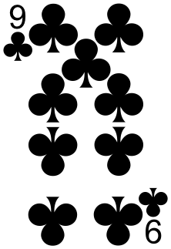
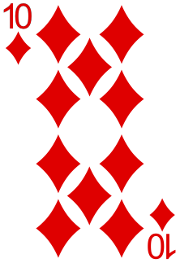
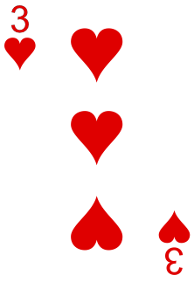
Finally AutoML
Great option for custom labels
Allows training
With as few as 100 images
Maybe eventually export model for edge processing
“Magic”
“Magic”
Confidence=99%
“Playing”

Slide 16
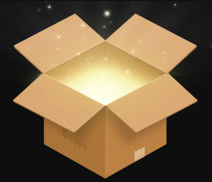
Deploy the App to GCP!

Slide 17
Questions
Code and images available on GitHub
https://github.com/richardagreene/PERTHdotnet-CardVision
Presentation in GitHub repository

